Slide 1
Domain – Sales
Dataset – Housing Price Prediction using Linear regression
Team Members
Vishal Raj V
Kesavan S
Venkat VK
Ajay Krishnan BS

Slide 2
About the Dataset
This data set contains a single file which compares various features of houses and price of the house.
The Problem statement is-to predict price of the house; given its features.
The target variable is continuous, hence it comes under SLR.
Total rows and columns are 545 rows and 13 columns

Slide 3
Variables in the Dataset
Column Name | Description | Data Type
'price' | The price of the house (target variable). | Numeric
'area' | The area or size of the house in square feet. | Numeric
'bedrooms' | The number of bedrooms in the house. | Numeric
'bathrooms' | The number of bathrooms in the house. | Numeric
'stories' | The number of stories or floors in the house. | Numeric
'mainroad' | Categorical variable indicating whether the house is located near the main road or not. | Categorical
'guestroom' | Categorical variable indicating whether the house has a guest room or not. | Categorical
'basement' | Categorical variable indicating whether the house has a basement or not. | Categorical
'hotwaterheating' | Categorical variable indicating whether the house has hot water heating or not. | Categorical
'airconditioning' | Categorical variable indicating whether the house has air conditioning or not. | Categorical
'parking' | The number of parking spaces available with the house. | Numeric
'prefarea' | Categorical variable indicating whether the house is in a preferred area or not. | Categorical
'furnishingstatus' | The furnishing status of the house (e.g., unfurnished, semi-furnished, fully furnished). | Categorical

Slide 4
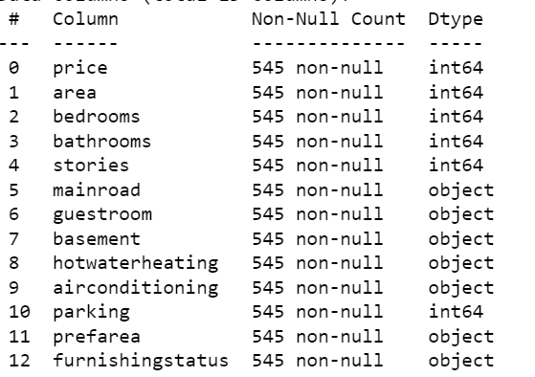
Understanding the data
Python Code - df.info()
Output -

Slide 5
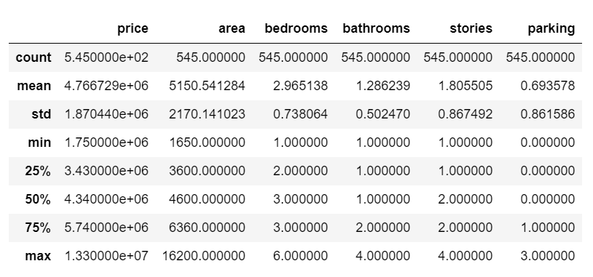
5 Point Summary
Python Code - df.describe()
Output -

Slide 6
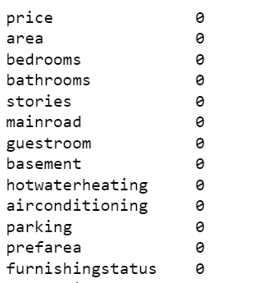
Checking for null values
Python Code - df.isnull().sum()
Output -
The inference we can make after checking for null values and finding that there are no null values in any of the columns is that the dataset is complete in terms of missing values.
Having no null values is beneficial because it allows us to work with the entire dataset without the need for imputation or handling missing data.

Slide 7
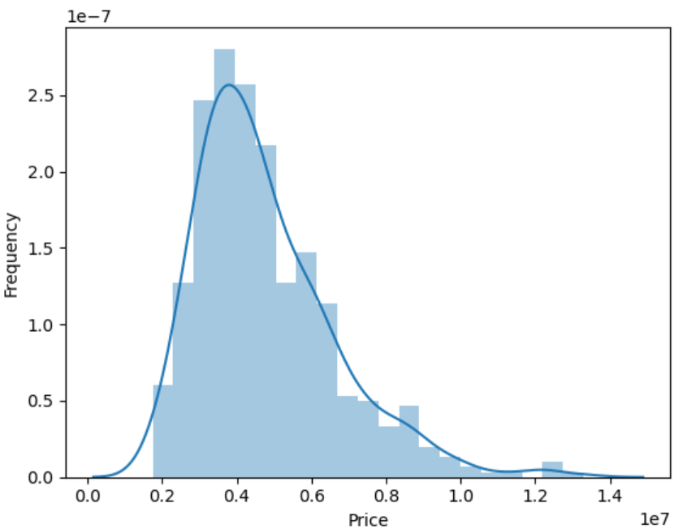
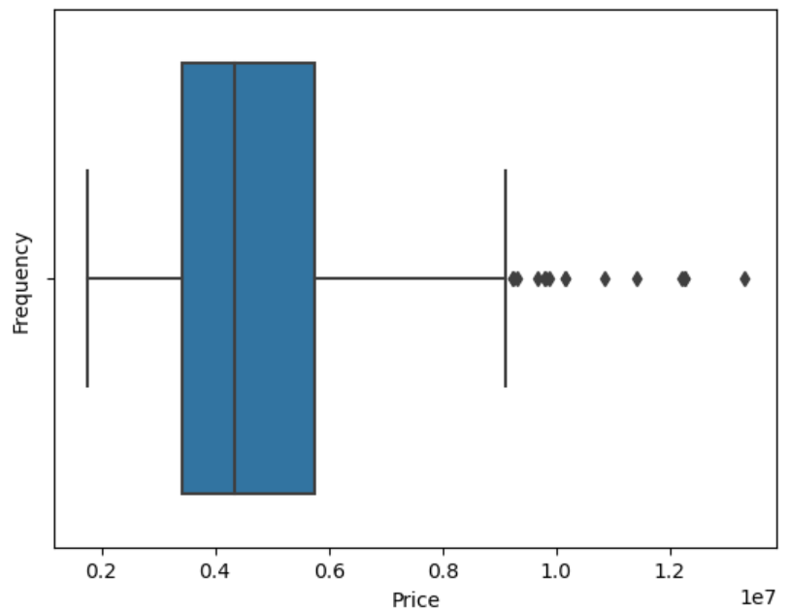
Exploratory Data Analysis
sns.histplot(df['price'],kde=True)
sns.boxplot(x='price', data=df)
The Price data (dependent variable) is right skewed).
There are a few outliers in the price column.

Slide 8
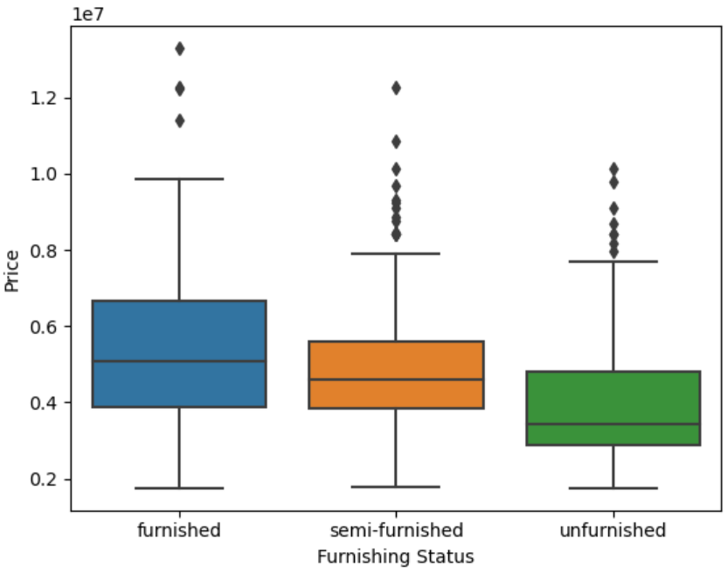
Exploratory Data Analysis
Distribution of data with respect to Furnishing Status.
sns.boxplot(x='furnishingstatus', y='price', data=df)
50% of the furnished houses costs similar to unfurnished houses
Most outliers are present in semi- furnished houses

Slide 9
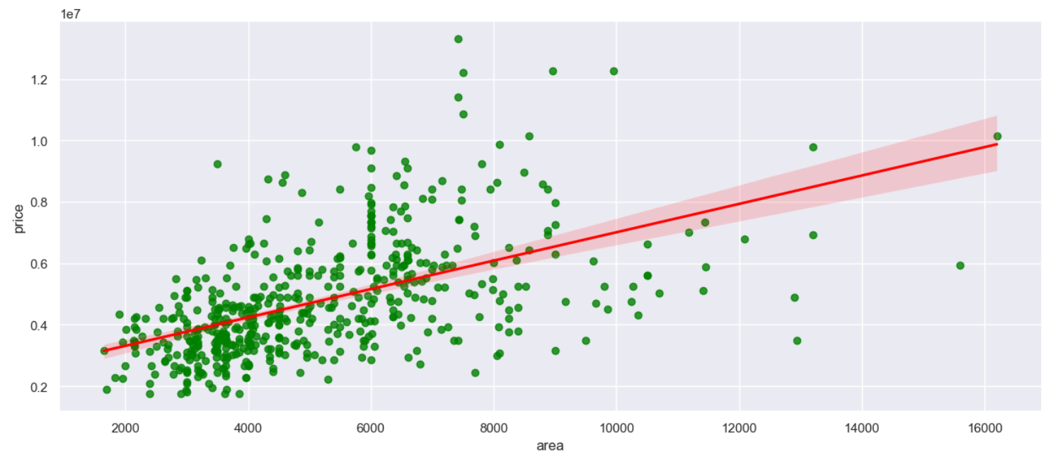
Exploratory Data Analysis
Area vs Price Scatterplot
sns.regplot(data=df,x='area', y='price', scatter=True, color='green', line_kws={"color": "red"})
There seems to be a +ve correlation between price of the house and area of the house.
Count of houses with area between 2000 and 8000, and price between 0.2 and 0.8.

Slide 10
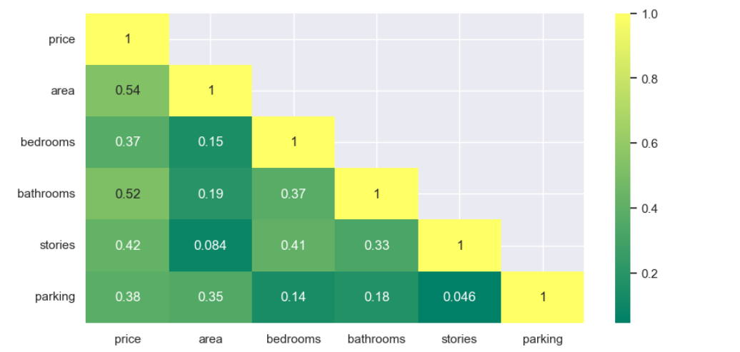
Exploratory Data Analysis
Correlation Heatmap
sns.heatmap(df.corr(),annot=True,cmap='summer',mask=np.triu(df.corr(),+1))
There do not seems to be any high correlation between independent variables
There seem to be little correlation between area and Price

Slide 11
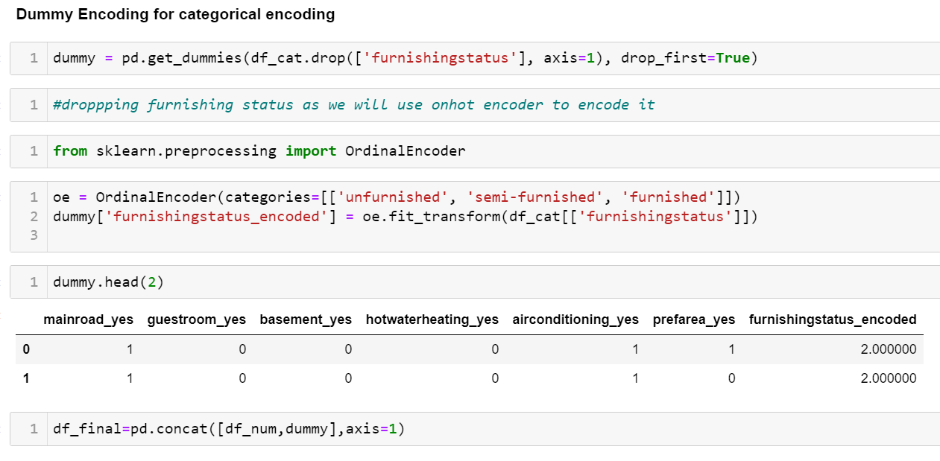
Data Cleaning and Preparation
Separating Categorical and Numerical data
df_cat=df.select_dtypes(include='object')
df_num=df.select_dtypes(include=np.number)
Encoding Categorical Variables with dummy encoder and ordinal encoder.

Slide 12
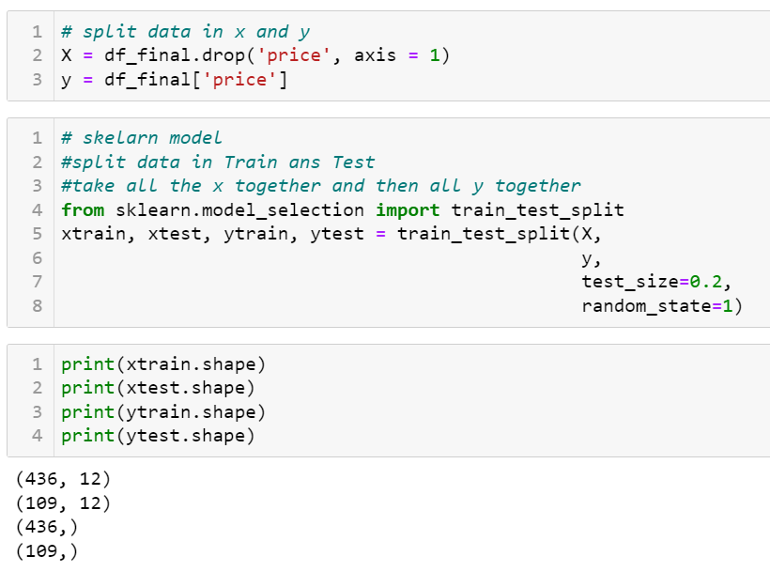
Building Model
Splitting Dependent and Independent Variable and train test split to build the model

Slide 13
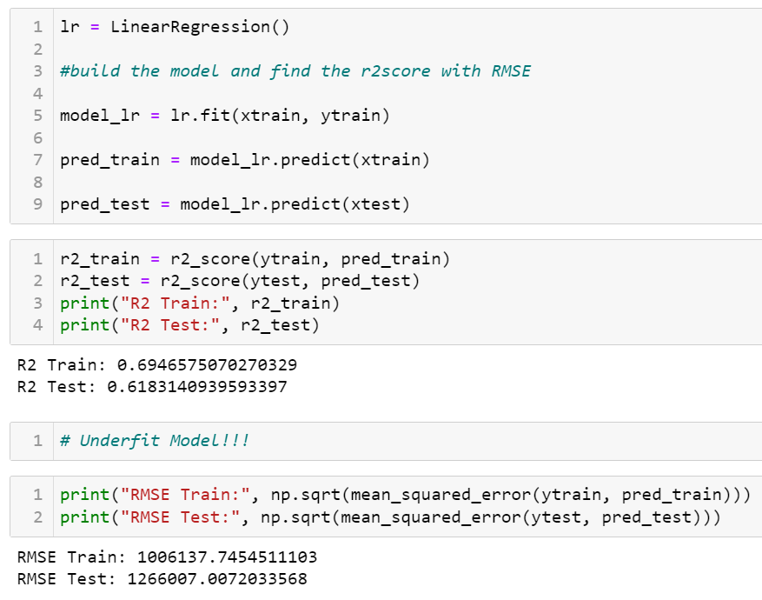
Linear Regression

Slide 14
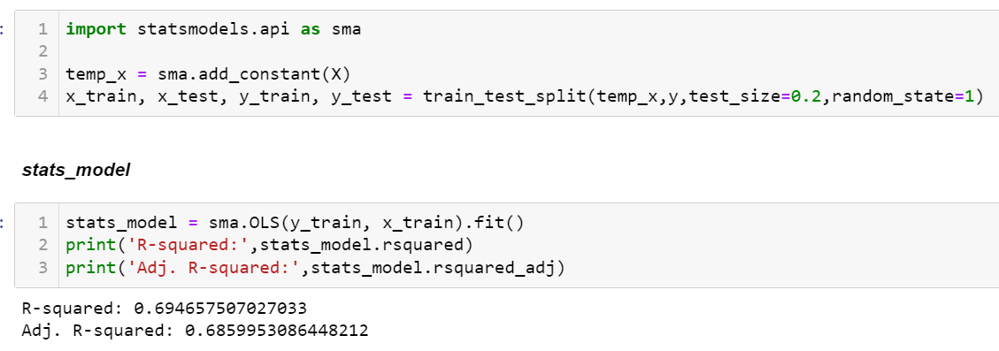
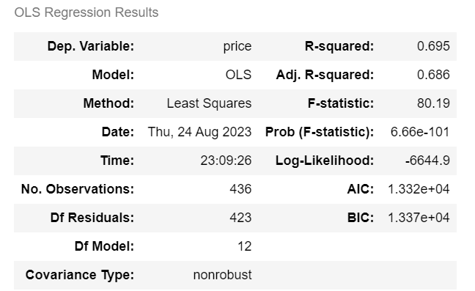
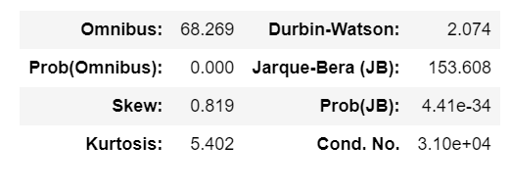
Stats Model
Durbin-Watson : 2.074
hence very less autocorrelation

Slide 15
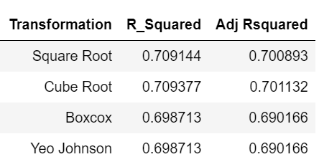
Transformation (R_squared, Adj Rsquared)

Slide 16
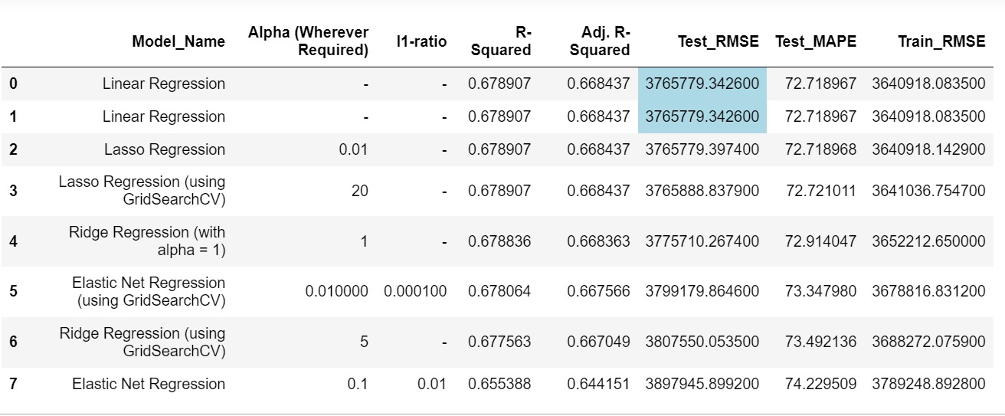
Regularisation

Slide 17
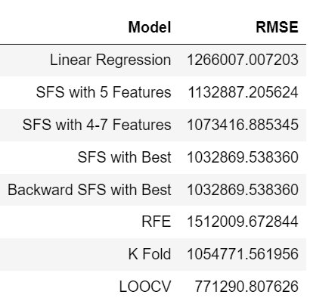
Model RMSE

Slide 18


Thank You!!

